Slide 1

DANE COUNTY
DEPARTMENT HUMAN SERVICES

Slide 2

DANE COUNTY
DEPARTMENT HUMAN SERVICES

Slide 3

s

Slide 4
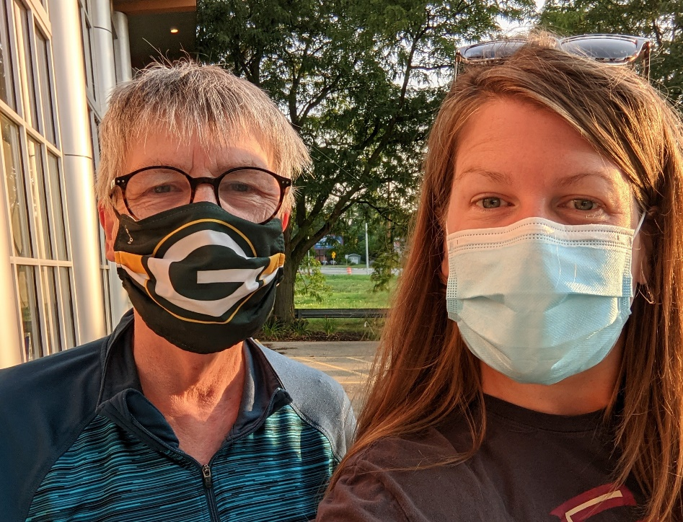
EXAMPLE
s
Mom and daughter, walking together for 47 years!

Slide 5

EXAMPLE
s

